Slide 1
AEMR Case
Guanhua Lu (Allen)

Slide 2
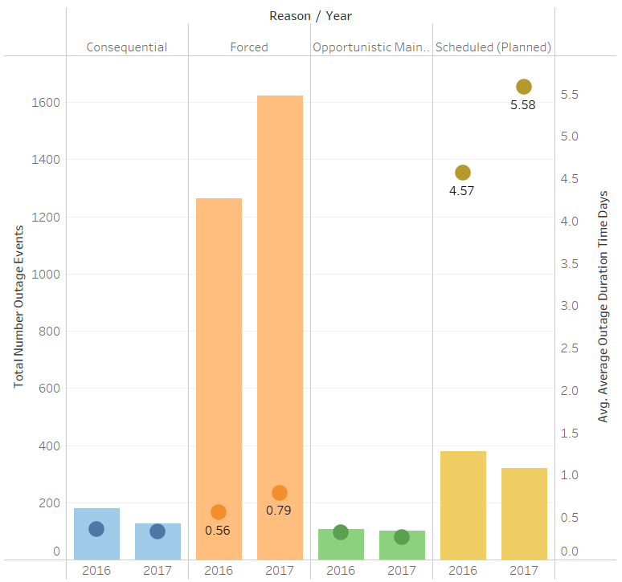

Warning Sign: Both The Number of Forced Outage Events and Avg Duration on the rise

Slide 3
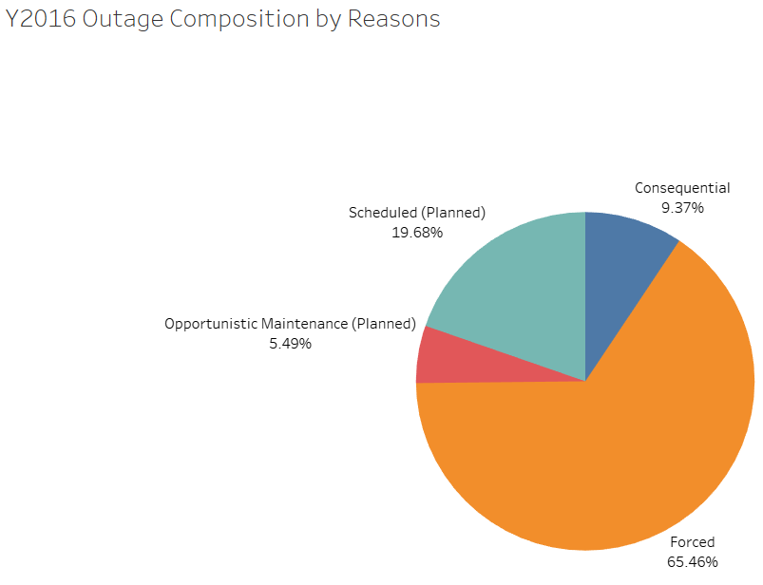
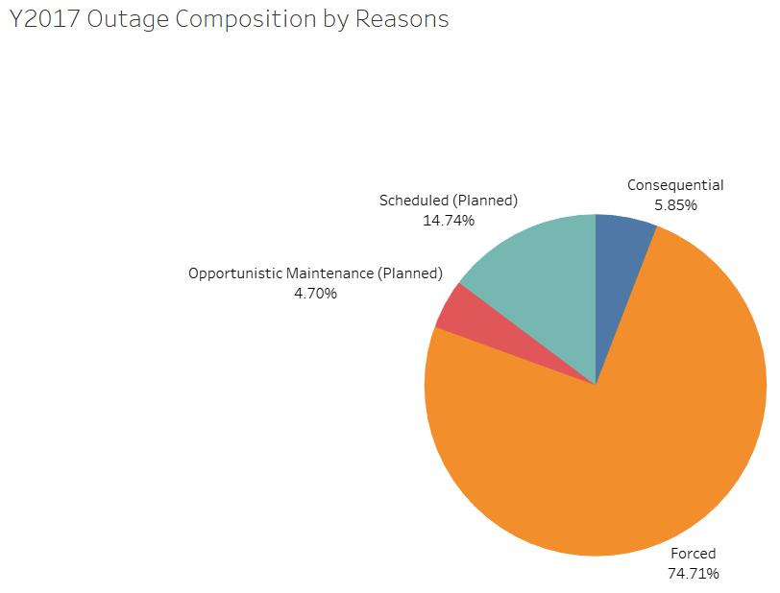
Forced Outage went up by 9% in 2017

Slide 4
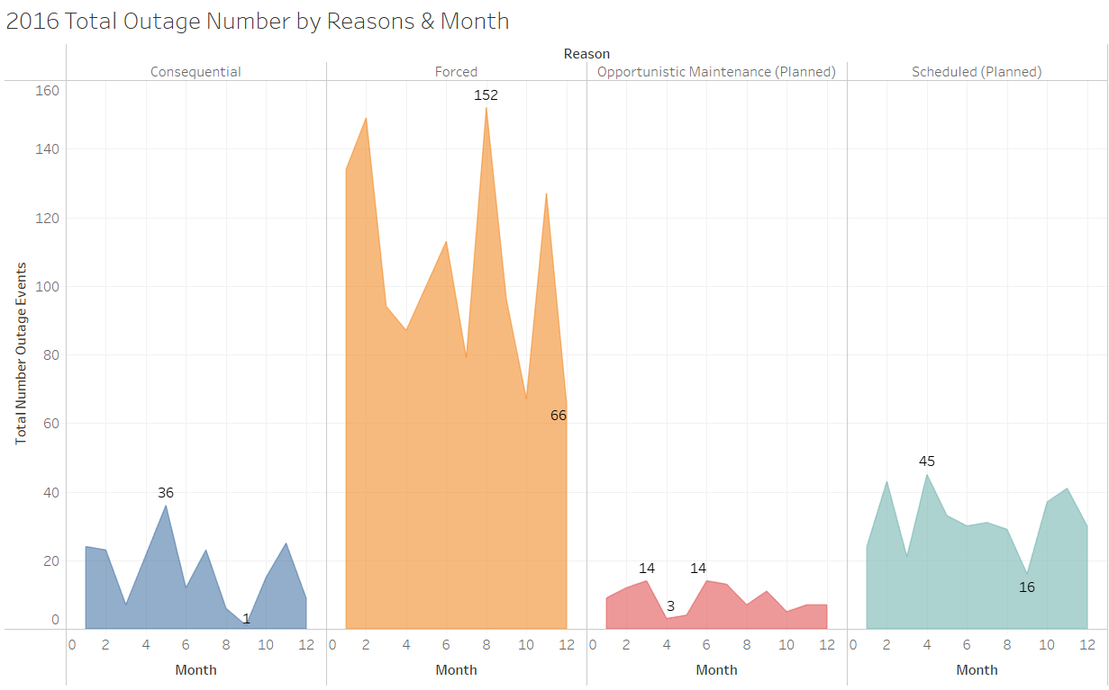
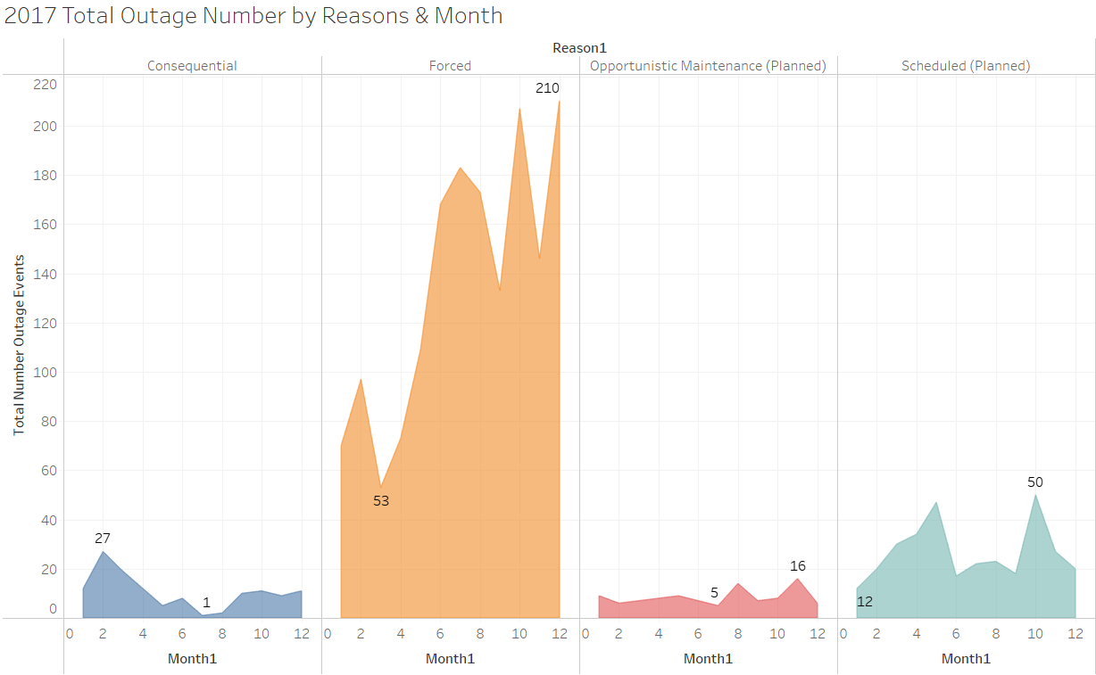
Mar17, a Turning Point for Forced Outage

Slide 5
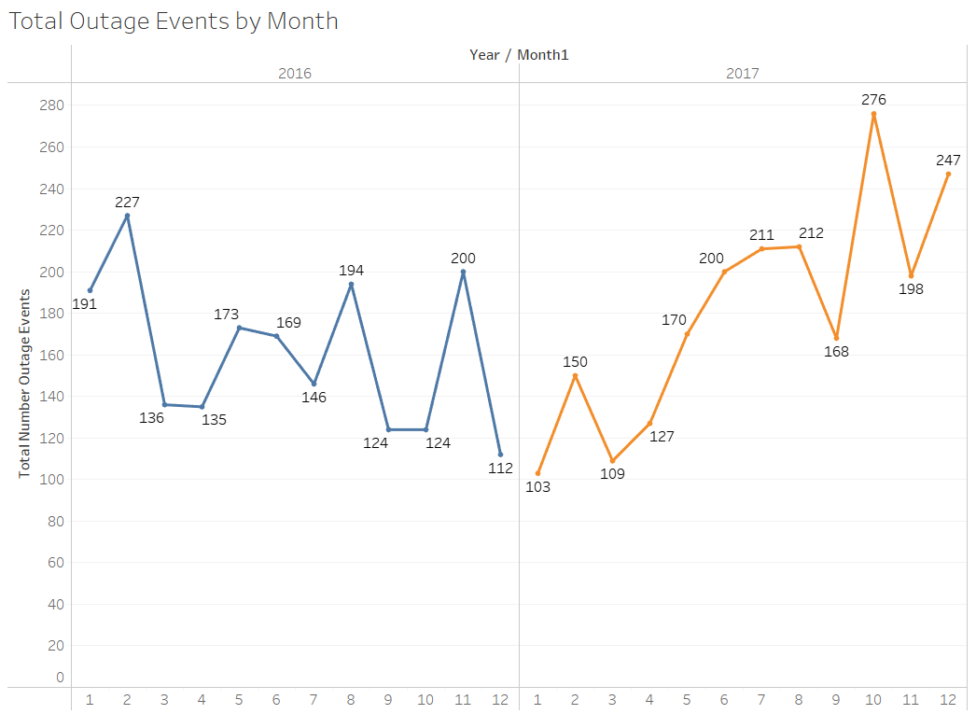
Total Outages in 2017 Trending up from March

Slide 6
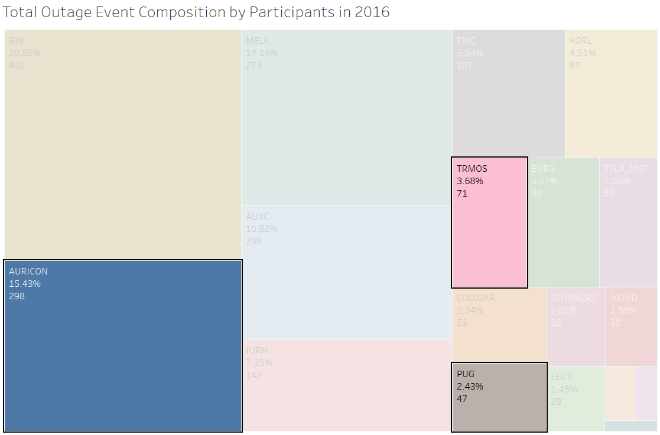
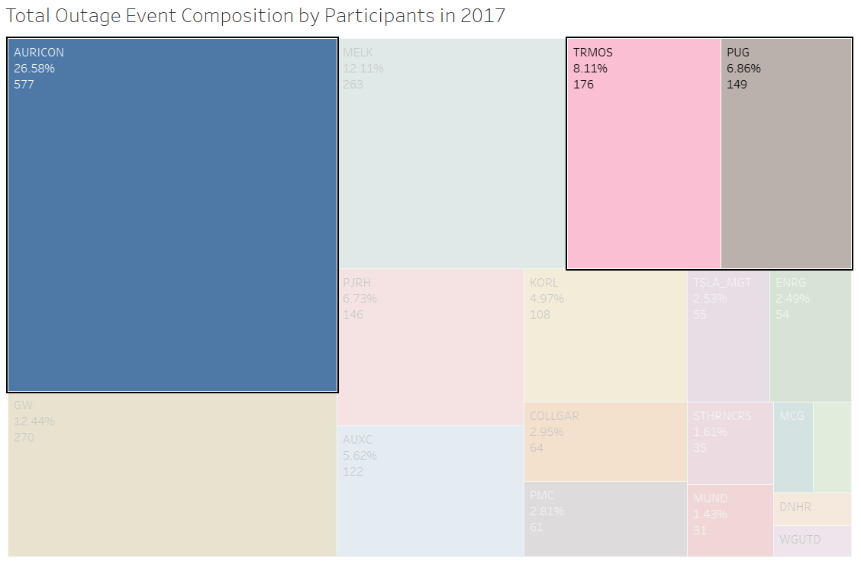
What Went WRONG?
Auricon
Trmos
Pug
Notes:
All reasons

Slide 7
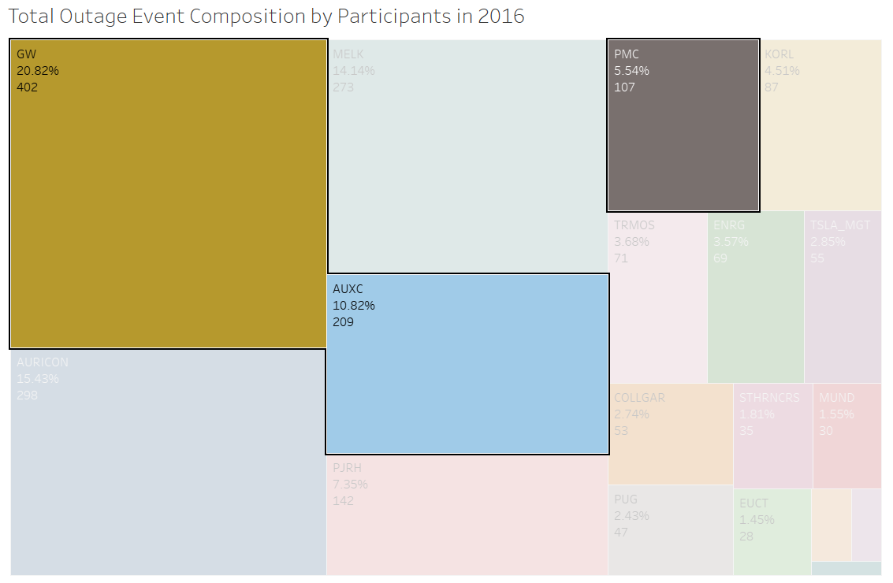
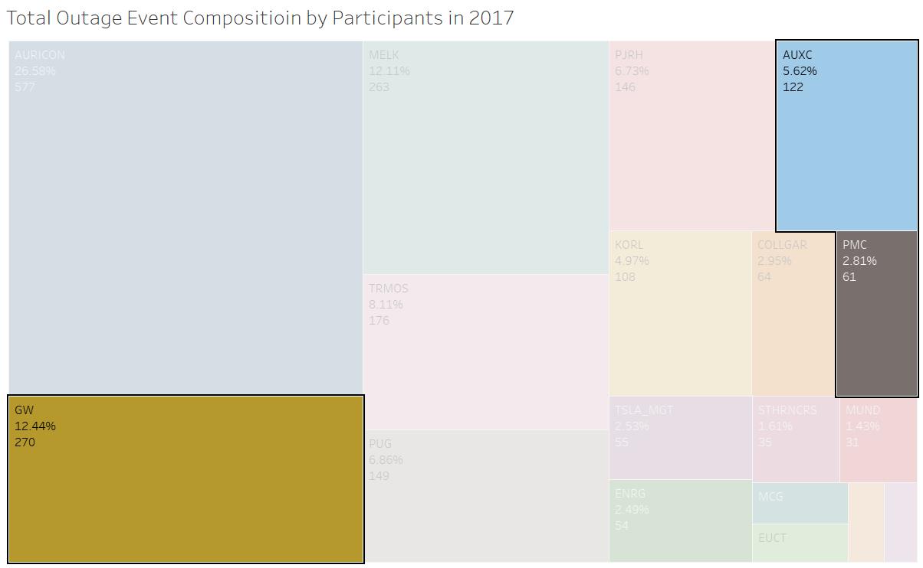
Which Suppliers improved?
GW
AUXC
PMC
Notes:
GW, AUXC, PMC

Slide 8
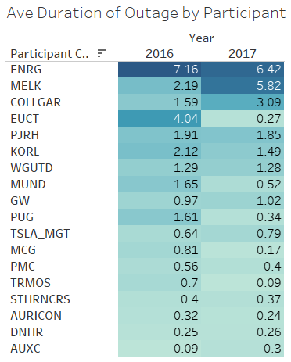
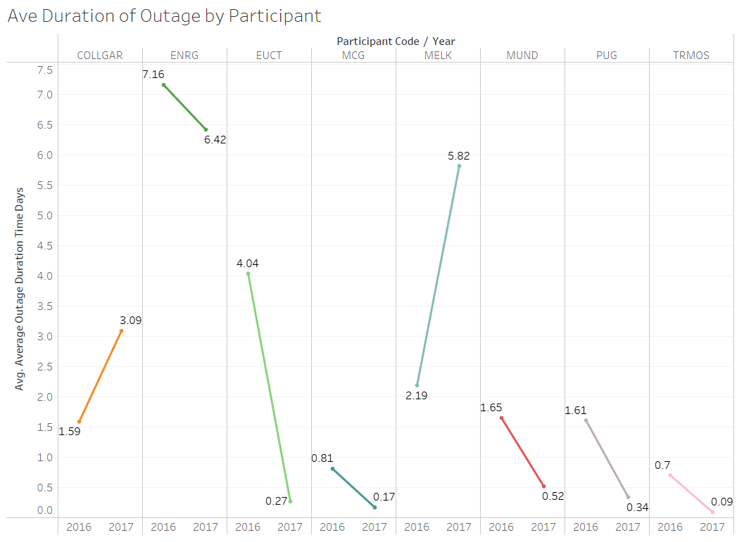
Melk Average Duration Outage More than Double
Notes:
All reasons

Slide 9
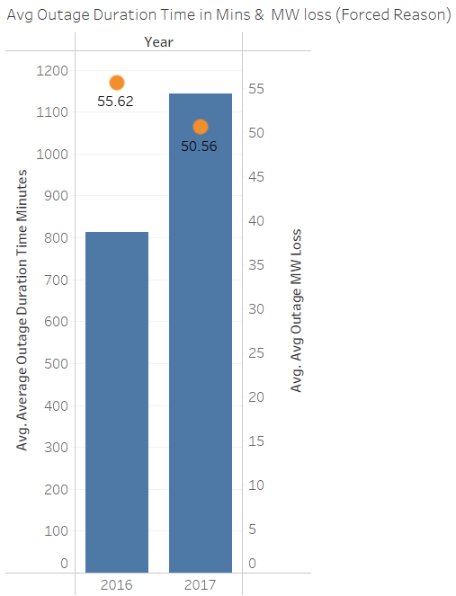
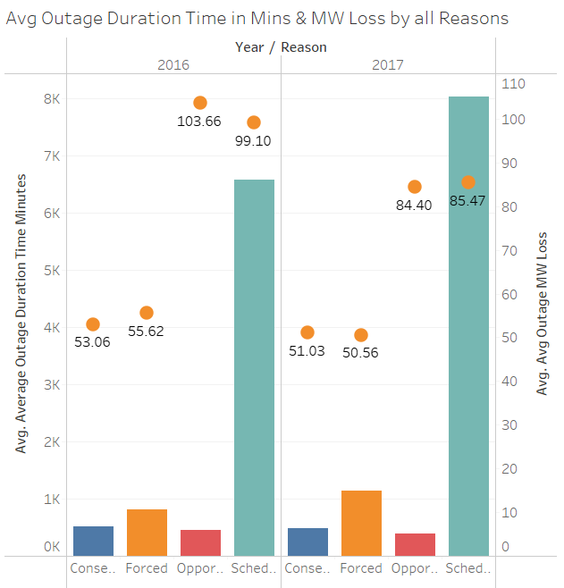
Avg Outage Duration went UP, while Avg Loss went Down

Slide 10
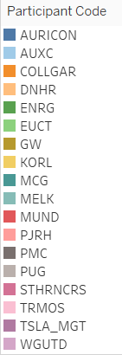
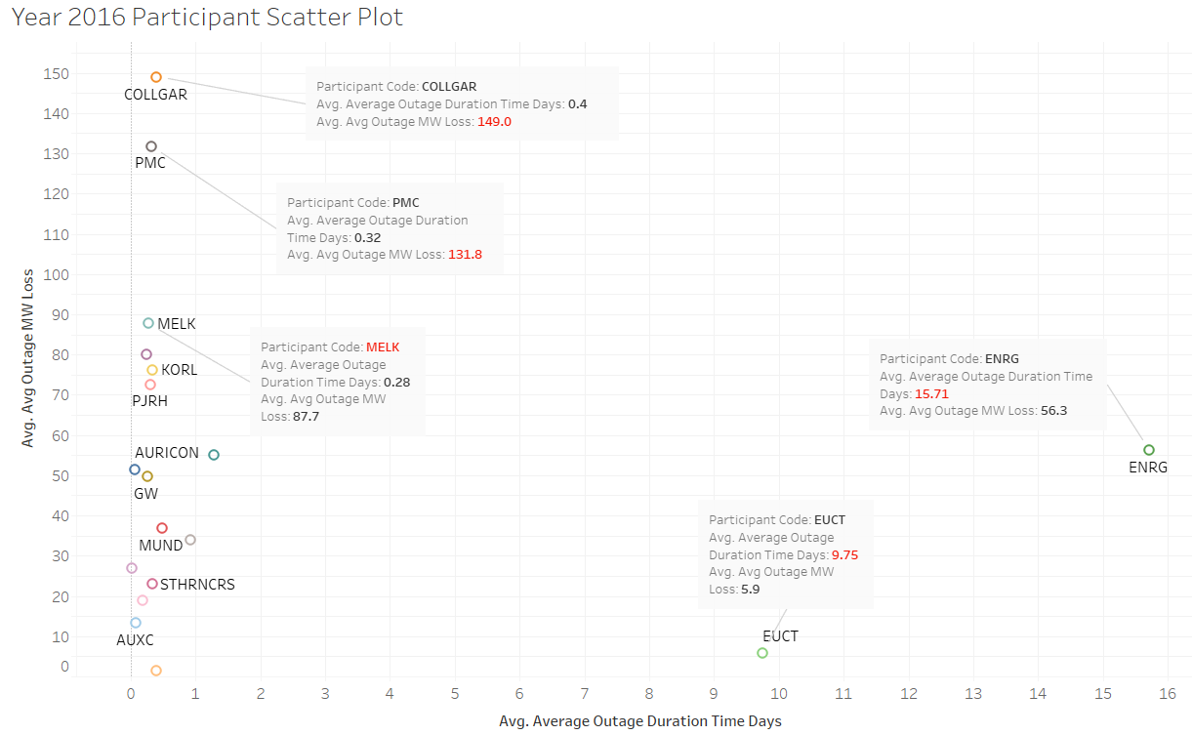
Check out those Outliers
Notes:
Forced Reason

Slide 11
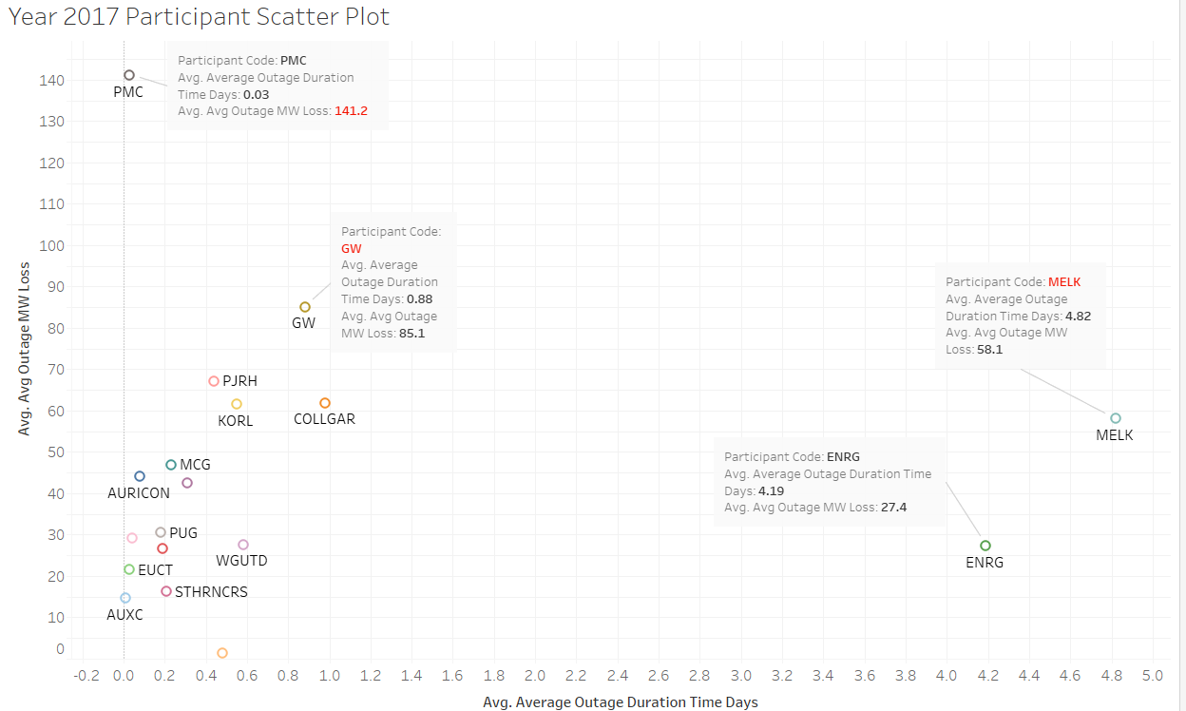
GW & MELK Avg MW Loss, a bit high
Notes:
Forced reason

Slide 12
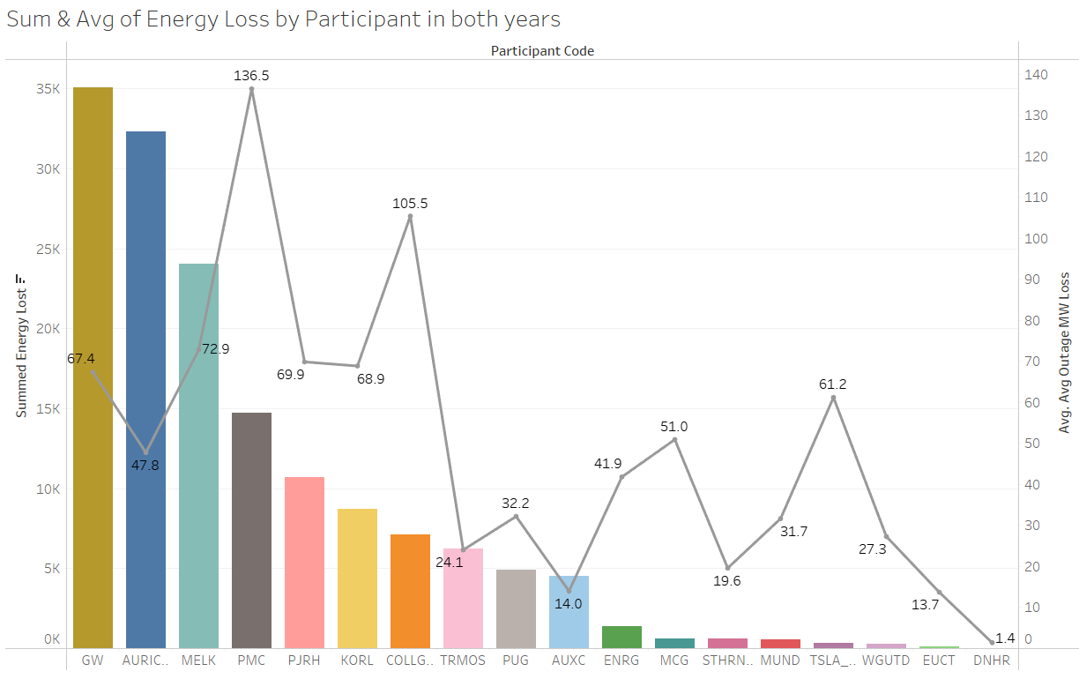
A few Outliers PMC, COLLGAR, TSLA_MGT
Notes:
All forced reasons , b3.2

